Slide 1
Application Layer Protocols & Network Security Basics
Protocols for efficient data transfer and communication in computer networks
Dr. Shashi Bhushan
Assistant Professor

Slide 2
Core Topics:
Protocols: HTTP, HTTPS, FTP, DNS, DHCP, SMTP
Network Security: SSL/TLS, Firewalls, Encryption (basic)
DNS Resolution Process
Secure Communication Practices
case studies on DNS spoofing, phishing, and MITM attacks.

Slide 3
What are Application Layer Protocols?
Applications running on various devices can communicate more easily by a group of protocols known as application layer protocols,
which operate at the top layer of the OSI model.
Application layer protocols define how applications running on different devices pass messages to each other over a network.
These protocols support numerous services, including email, web browsing, and file transfer, and they define the structure and content of the transmitted data.
Each protocol has its own set of rules and specifications that define how messages can be transmitted and received between different devices on a network.

Slide 4
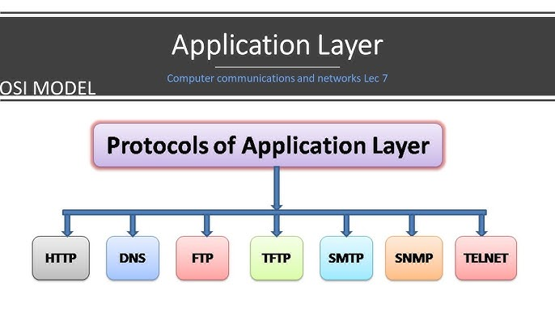

Slide 5
Hypertext Transfer Protocol (HTTP)
HTTP (Hypertext Transfer Protocol) is a fundamental protocol of the Internet, enabling the transfer of data between a client and a server.
HTTP (Hypertext Transfer Protocol) is the set of rules for transferring files (text, graphic images, sound, video, and other multimedia files) on the World Wide Web. As soon as a Web user opens their Web browser, the user is indirectly making use of HTTP.
When the browser user enters file requests by either "opening" a Web file (typing in a Uniform Resource Locator or URL) or clicking on a hypertext link, the browser builds an HTTP request and sends it to the Internet Protocol address (IP address) indicated by the URL.
The HTTP daemon in the destination server machine receives the request and sends back the requested file or files associated with the request. (A Web page often consists of more than one file.)

Slide 6
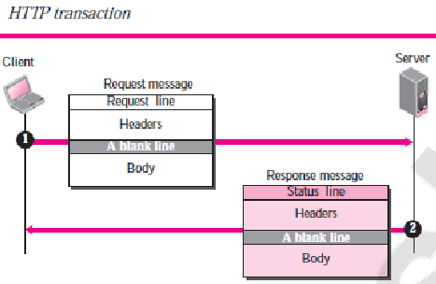
HTTP Transaction
Although HTTP uses the services of TCP, HTTP itself is a stateless protocol, which means that the server does not keep information about the client.

Slide 7
What is an HTTP Request?
HTTP request is simply termed as the information or data that is needed by Internet browsers for loading a website. This is simply known as HTTP Request.
There is some common information that is generally present in all HTTP requests. These are mentioned below.
HTTP Version
URL
HTTP Method
HTTP Request Headers
HTTP Body

Slide 8
HTTP Methods
HTTP methods (also called verbs) are instructions in the HTTP protocol that tell a web server what action to perform on a resource. They indicate the desired action, such as retrieving, submitting, updating, or deleting data.
HTTP Method | Function
GET | Retrieves data from the server. It is safe and idempotent (does not change server state). Commonly used to fetch resources like HTML pages, images, or data from an API.
POST | Sends data to the server, typically to create a new resource. Often used in form submissions or API calls to add data.
PUT | Updates an existing resource or creates it if it does not exist. Sends the full updated data to the server.
DELETE | Removes the specified resource from the server.
HEAD | Similar to GET, but it only retrieves the headers, not the body. Useful for checking if a resource exists or getting metadata.
CONNECT | Establishes a tunnel to the server, typically used for SSL (HTTPS) connections.

Slide 9
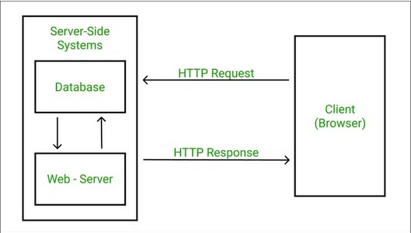
HTTP REQUEST
An HTTP request is a message sent by a client (usually a web browser or app) to a server to request a resource or perform an action. It is a core part of the HyperText Transfer Protocol (HTTP) used on the web.
A request message consists of a request line, a header, and sometimes a body

Slide 10
What is HTTP Response?
HTTP Response is simply the answer to what a Server gets when the request is raised. There are various things contained in the HTTP Response, some of them are listed below.
HTTP Status Code
HTTP Headers
HTTP Body

Slide 11
Advantages of HTTP
Memory usage and CPU usage are low because of fewer simultaneous connections.
Since there are few TCP connections, network congestion is less.
Since handshaking is done at the initial connection stage, latency is reduced because there is no further need for handshaking for subsequent requests.
The error can be reported without closing the connection.
HTTP allows HTTP pipe-lining of requests or responses.

Slide 12
Disadvantages of HTTP
HTTP requires high power to establish communication and transfer data.
HTTP is less secure because it does not use any encryption method like HTTPS and uses TLS to encrypt regular HTTP requests and responses.
HTTP is not optimized for cellular phones, and it is too gabby.
HTTP does not offer a genuine exchange of data because it is less secure.
The client does not close the connection until it receives complete data from the server; hence, the server needs to wait for data completion and cannot be available for other clients during this time.

Slide 13
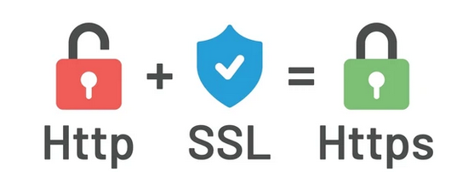
Hypertext Transfer Protocol Secure(HTTPS)
Hypertext Transfer Protocol Secure or Hypertext Transfer Protocol over SSL is used for secure communication over a network, or perhaps more importantly – over the Internet.

Slide 14
Key Features of HTTPS
Secure Version of HTTP
HTTPS is the secure version of HTTP, which uses encryption to protect data exchanged between the client and server.
Uses SSL/TLS Encryption
It encrypts the data using SSL (Secure Sockets Layer) or TLS (Transport Layer Security), preventing hackers from reading or tampering with the data.
Data Integrity and Authentication
HTTPS ensures that data is not altered during transmission and verifies the server’s identity through digital certificates.
Protects Sensitive Information
Commonly used for secure transactions like online banking, login forms, and e-commerce to protect passwords, credit cards, etc.
Indicated by Padlock Icon and 'https://'

Slide 15
HTTP VS HTTPS
Feature | HTTP | HTTPS
Security | No encryption | Encrypted (SSL/TLS)
Port | 80 | 443
Data Integrity | Vulnerable to tampering | Protected
Authentication | No identity check | SSL Certificate verified
SEO Impact | "Not Secure" warning | Better ranking
Speed | ⚡ Faster | Slightly slower (but optimized)

Slide 16
FAQ
What is the default port number for HTTP?
80
Which HTTP method is typically used to submit data to a server?
Post
Which HTTP method is typically used to download a web page.
GET

Slide 17
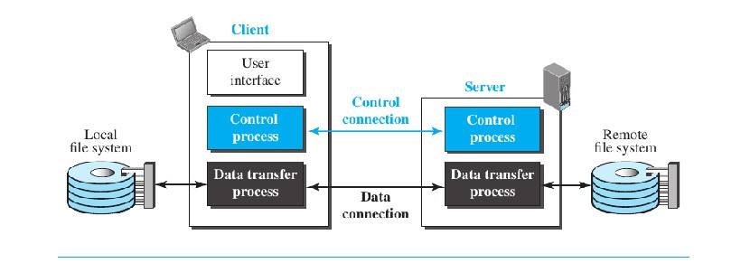
File Transfer Protocol (FTP)
File Transfer Protocol (FTP) is the standard mechanism provided by TCP/IP for copying a file from one host to another.
FTP uses the services of TCP
It needs two TCP connections
The well-known port 21 is used for the control connection and the well-known
port 20 for the data connection

Slide 18
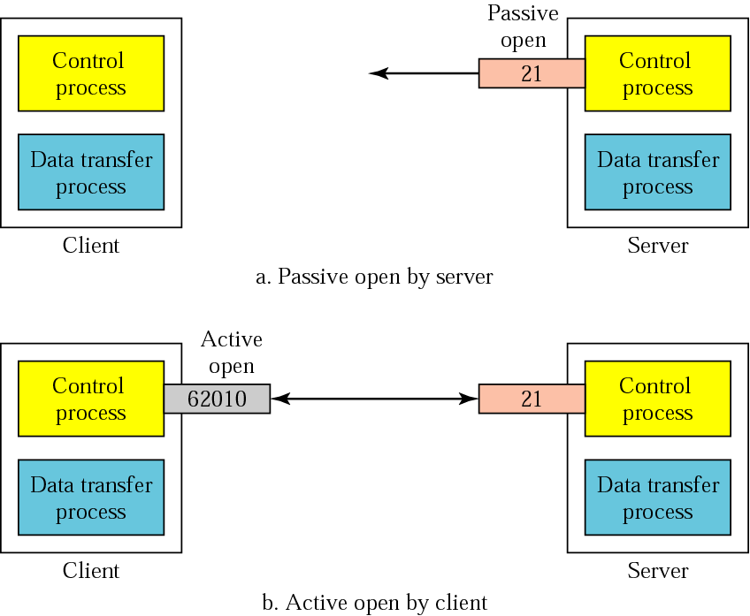
Opening the control connection

Slide 19
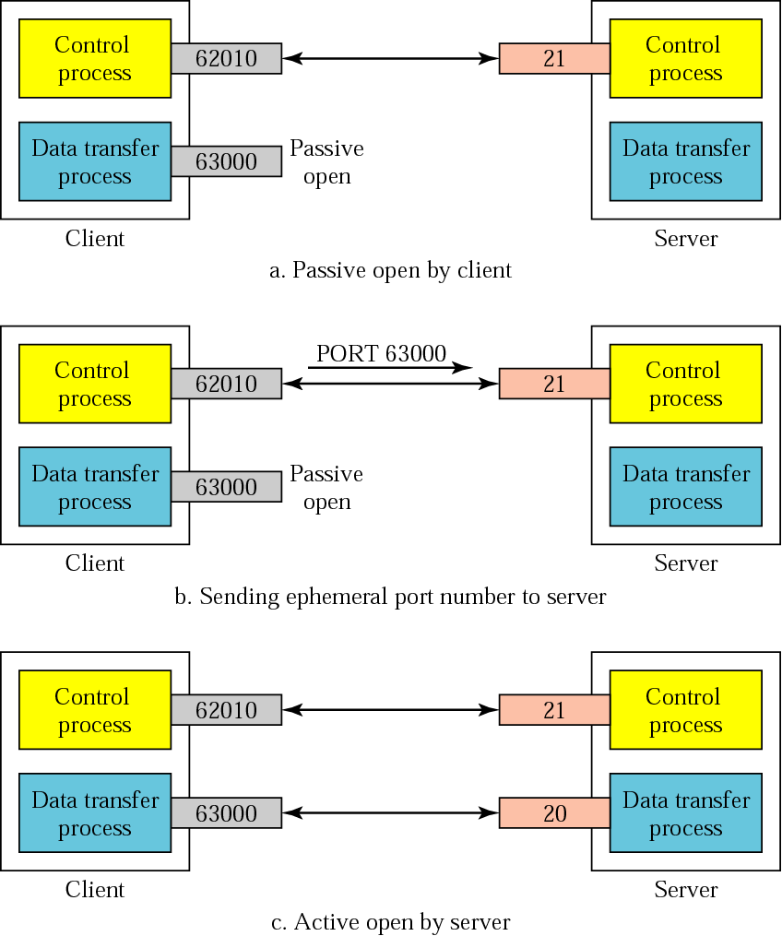
Creating the data connection

Slide 20
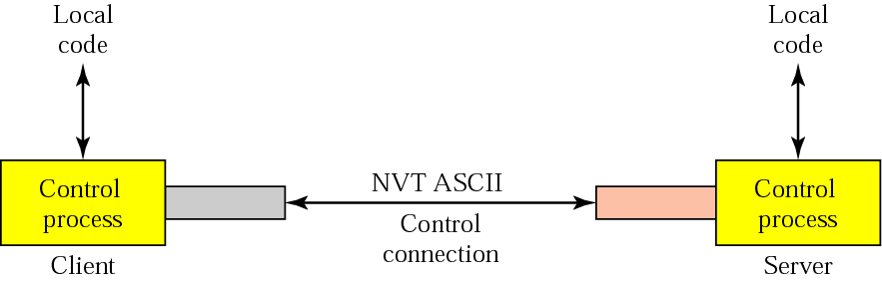
Using the control connection

Slide 21
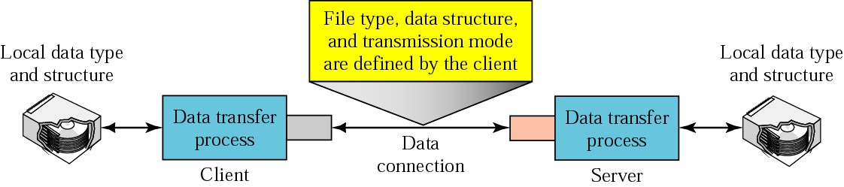
Using the data connection

Slide 22
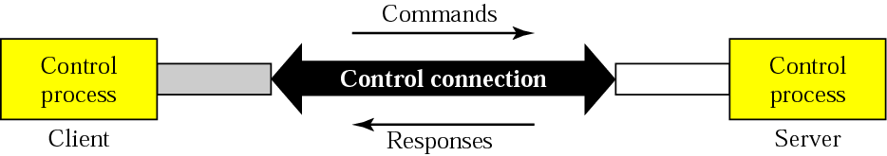
Command processing

Slide 23
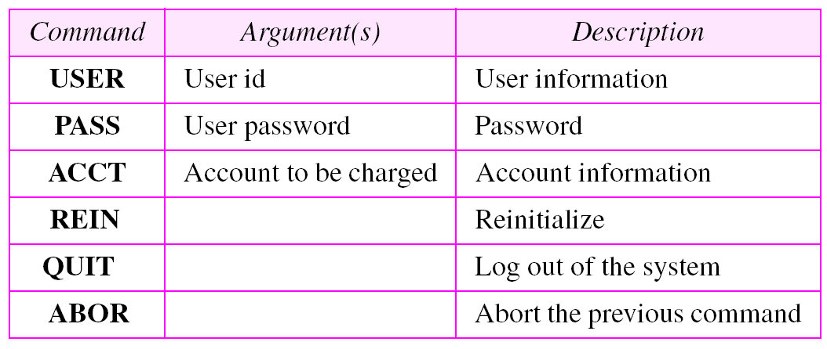
Access commands

Slide 24
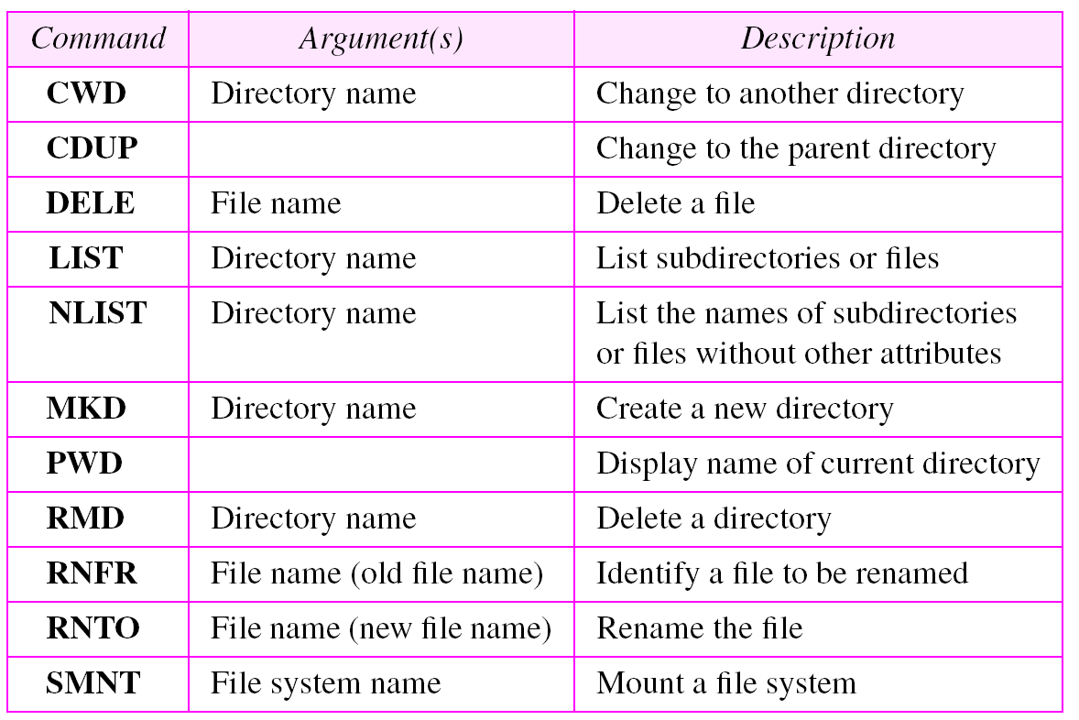
File management commands

Slide 25
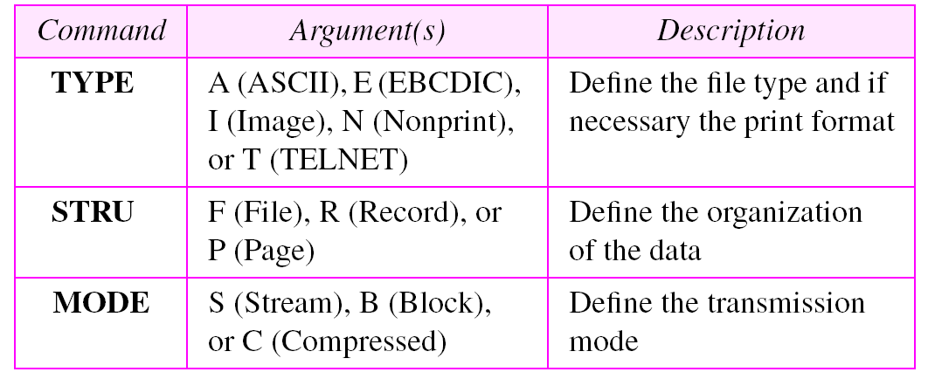
Data formatting commands

Slide 26
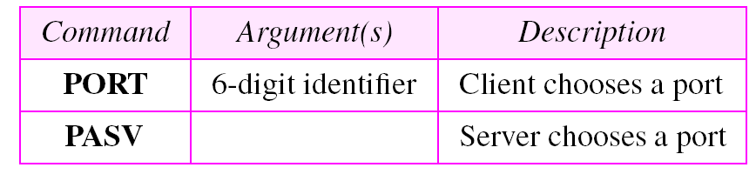
Port defining commands

Slide 27
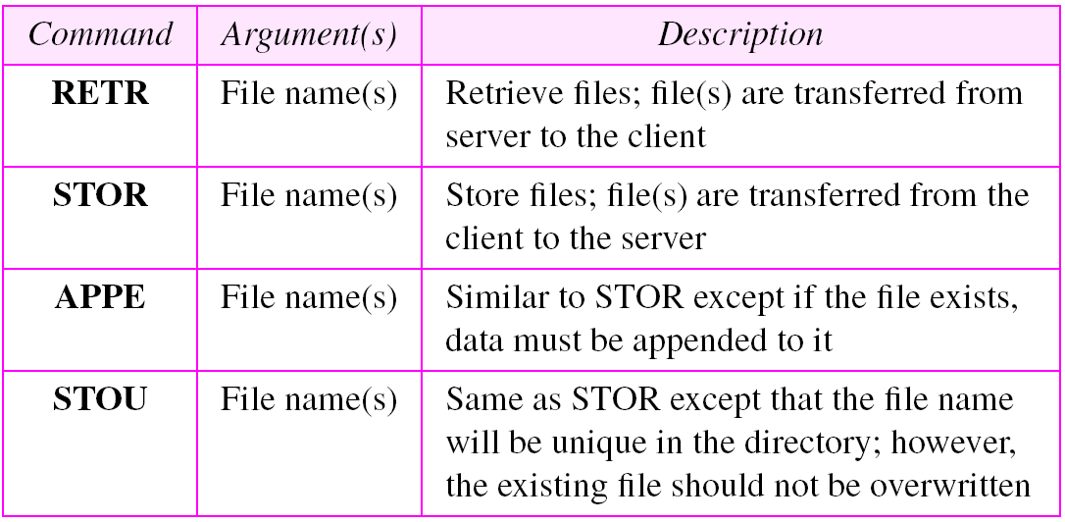
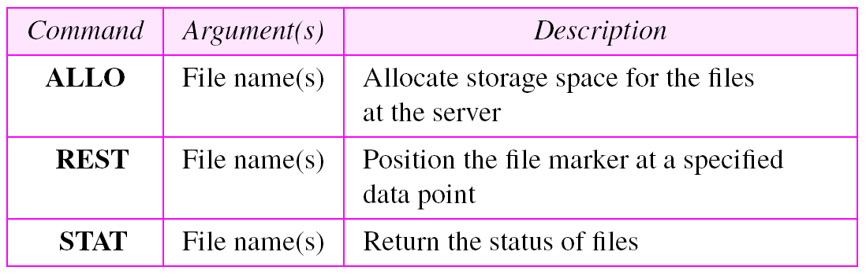
File transfer commands

Slide 28
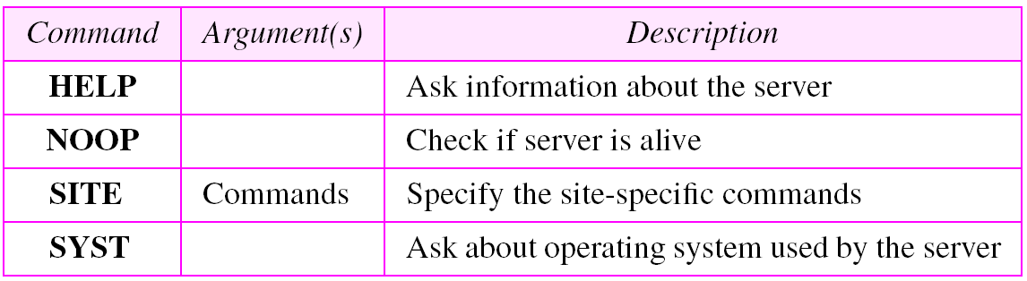
Miscellaneous commands

Slide 29
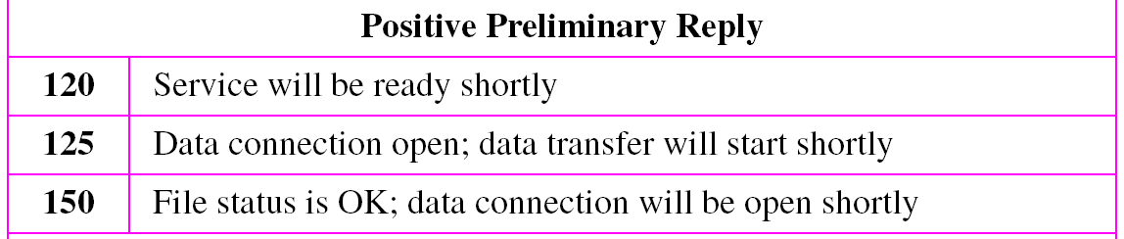
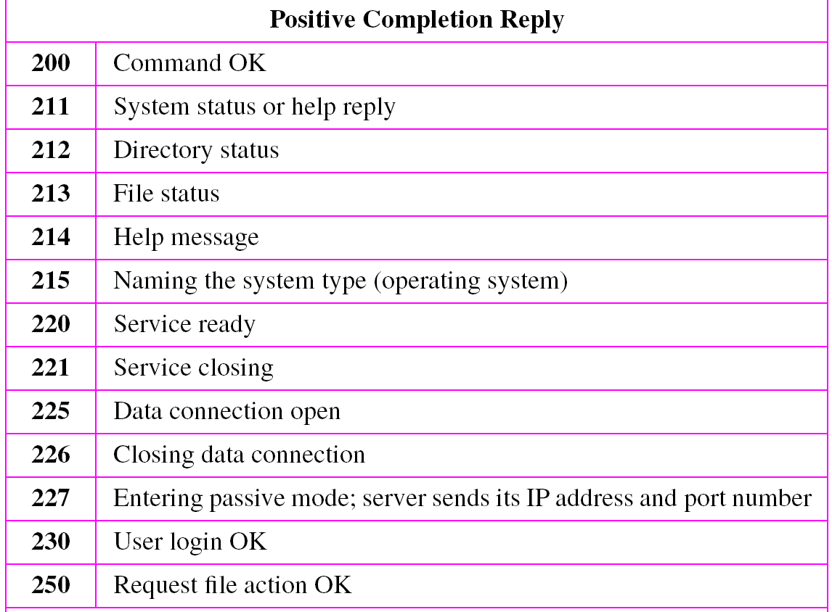
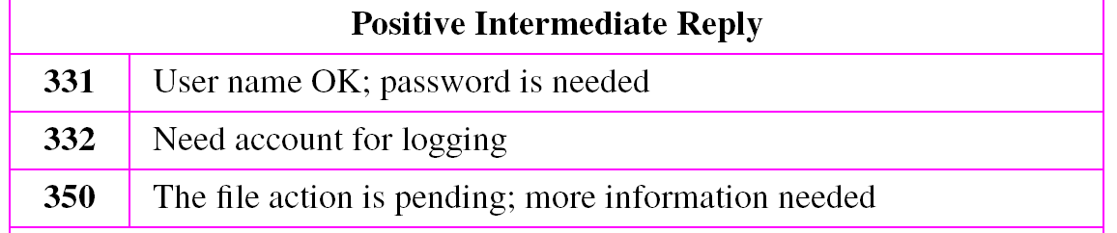
Response commands

Slide 30
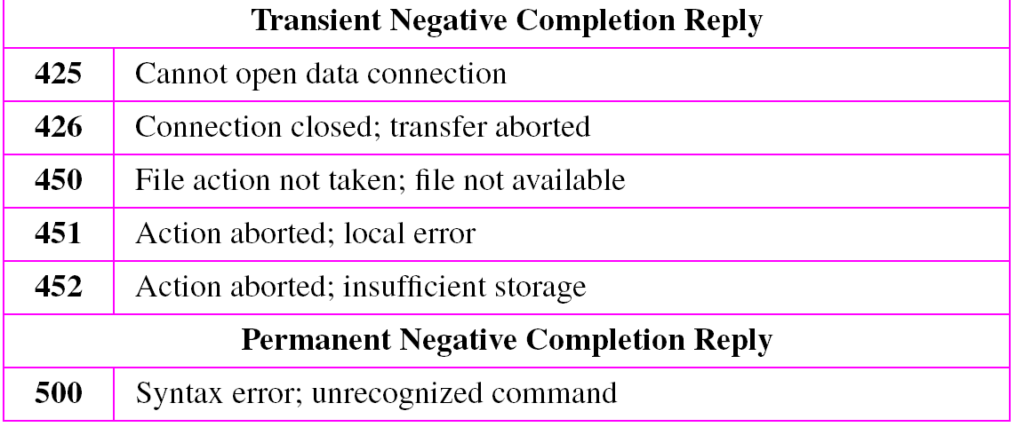
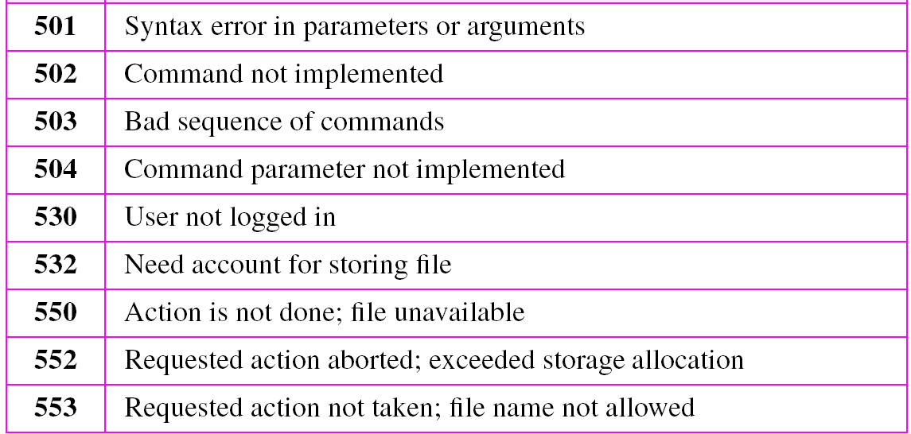
Response commands

Slide 31
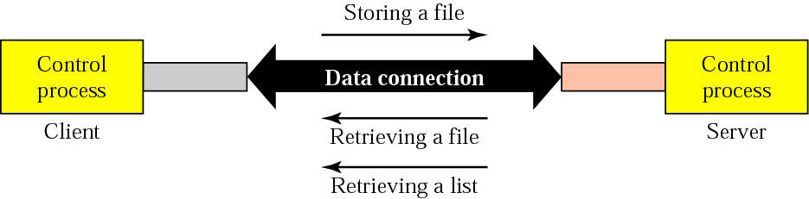
File transfer

Slide 32
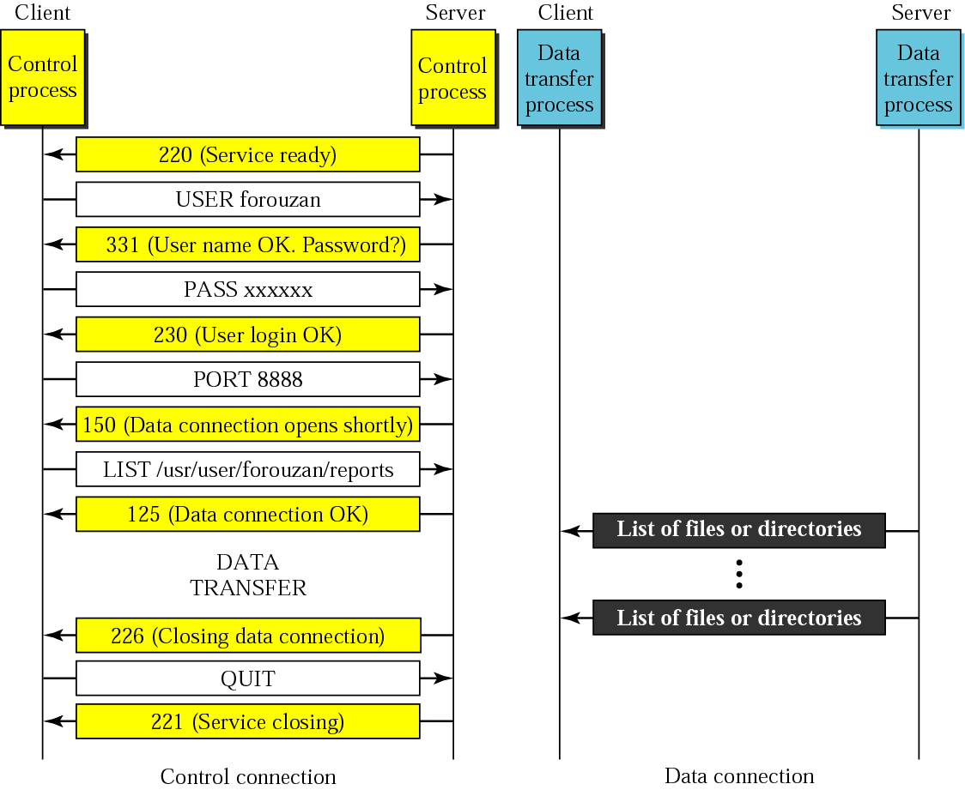
Example

Slide 33
FAQ File Transfer Protocol
What does FTP stand for? → File Transfer Protocol.
Which port is used by FTP for control connection? → Port 21.
What type of protocol is FTP based on? → TCP/IP.
What is the purpose of FTP? → To transfer files between a client and a server over a network.
Name the two modes of FTP connection. → Active mode and Passive mode.
Which FTP command is used to upload a file? → STOR.
Which FTP command is used to download a file? → RETR.
What is the difference between active and passive FTP mode? → In active mode, the server connects to the client; in passive mode, the client connects to the server.
Is FTP a secure protocol? → No, FTP transmits data in plain text.
Name one secure alternative to FTP. → SFTP (SSH File Transfer Protocol).

Slide 34
Domain Name Space (DNS)
Name space
The names assigned to machines must be unique because the addresses are unique
A name space that maps each address to a unique name can be organized in two ways
flat
hierarchical

Slide 35
Domain Name Space (DNS)
The domain name space is hierarchical in design
The names are defined in an inverted-tree structure with the root at the top
The tree can have 128 levels: level 0 (root) to level 127

Slide 36
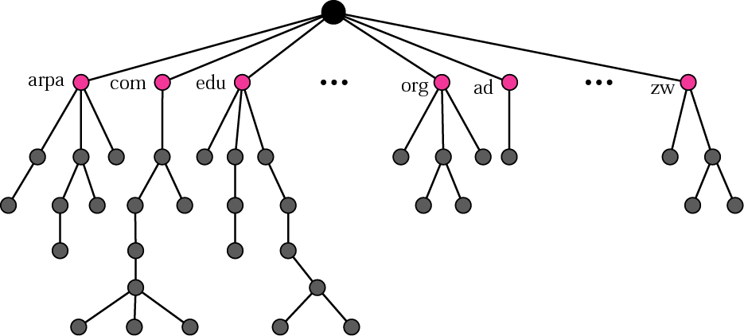
Domain Name Space (DNS)

Slide 37
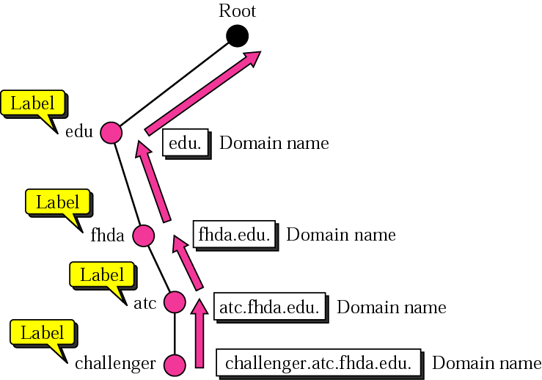
Domain Name and Labels
Domain -Each node in the tree has a domain name. A full domain name is a sequence of labels separated by dots (.). The domain names are always read from the node up to the root.
Each node in the tree has a label, which is a string with a maximum of 63 characters.

Slide 38
Distribution of name space
The information contained in the domain name space is distributed among many computers called DNS servers

Slide 39
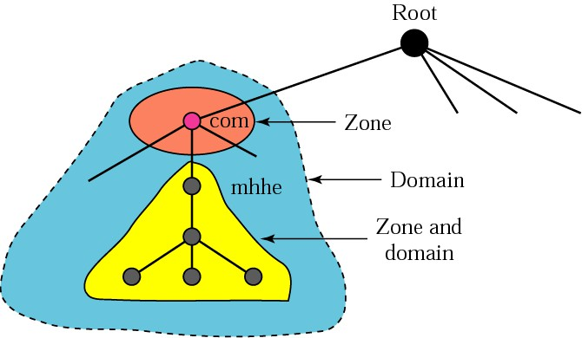
Zones and domains

Slide 41
Zones and domains
A primary server loads all information from the disk file
The secondary server loads all information from the primary server
When the secondary downloads information from the primary, it is called zone transfer

Slide 42
DNS in the internet
The domain name space (tree) is divided into three different sections
generic domains
country domains
inverse domain

Slide 43
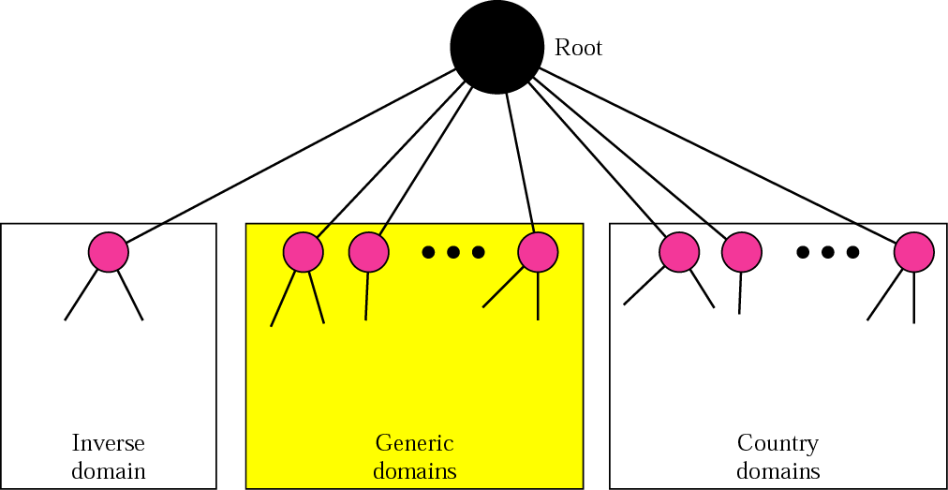
DNS used in the Internet

Slide 44
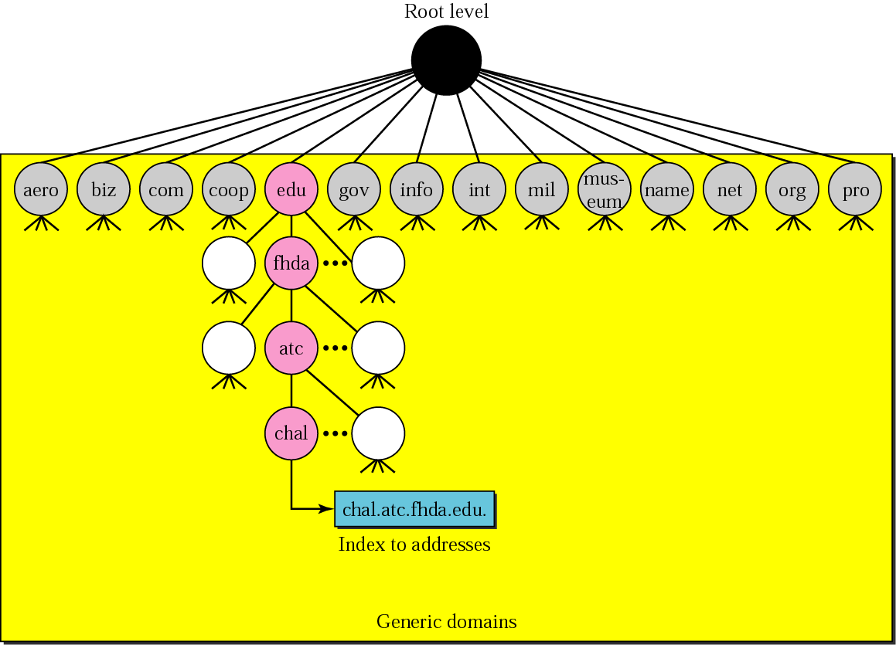
Generic domain

Slide 45
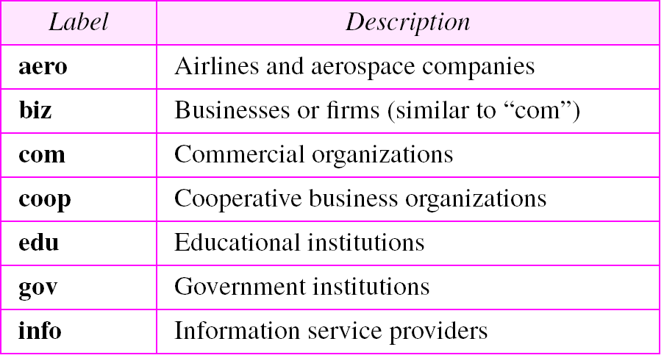
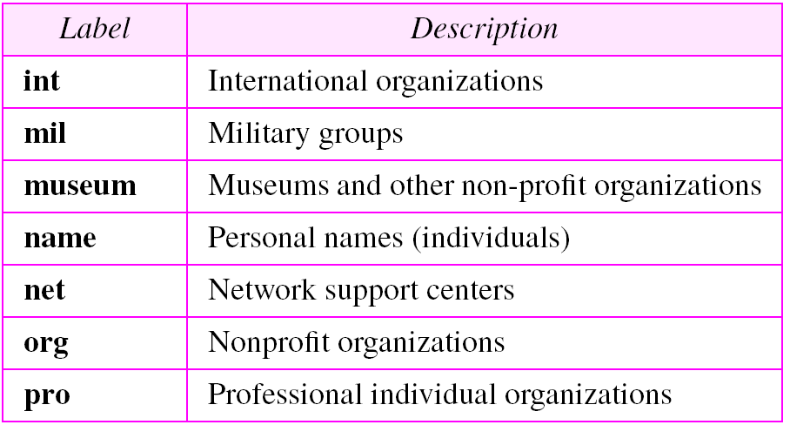
Generic domain labels

Slide 46
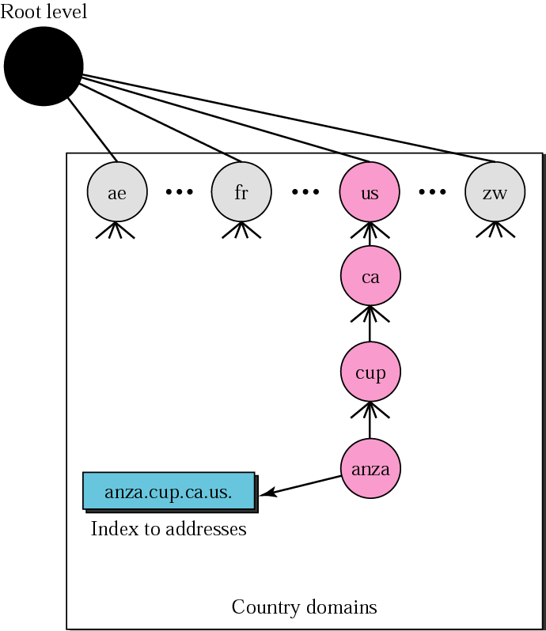
Country domain

Slide 47
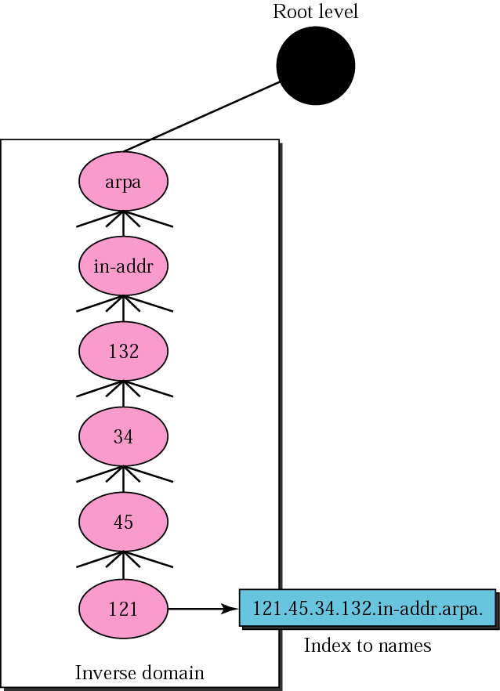
Inverse domain

Slide 48
Domain Resolution
Mapping a name to an address or an address to a name is called name-address resolution

Slide 49
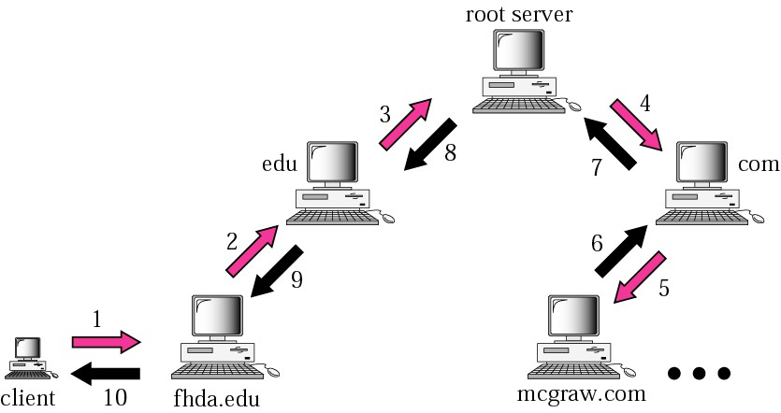
Recursive resolution

Slide 50
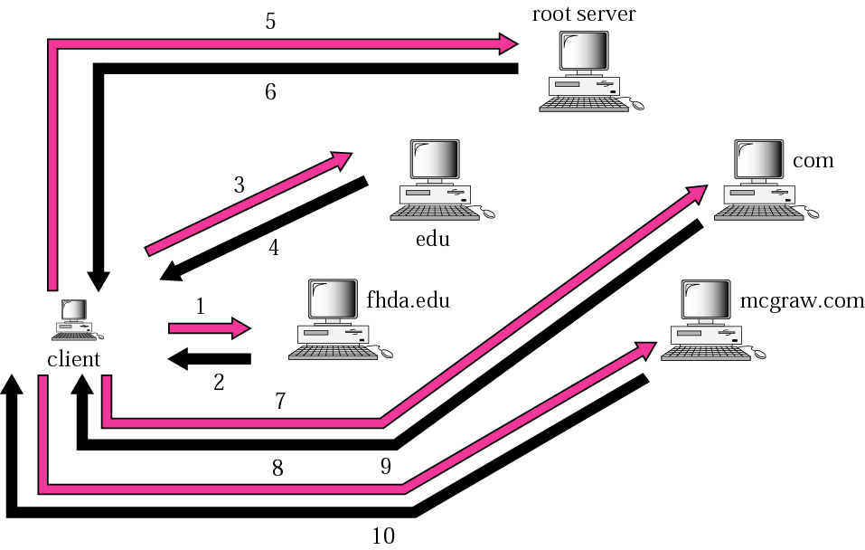
Iterative resolution

Slide 51
DNS messages
The DNS query message consists of a
Header
Question records
The DNS response message consists of a
Header
question records
answer records
authoritative records
additional records

Slide 52
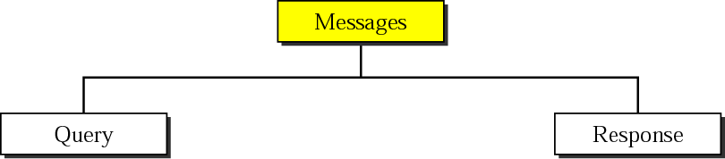
DNS messages

Slide 53
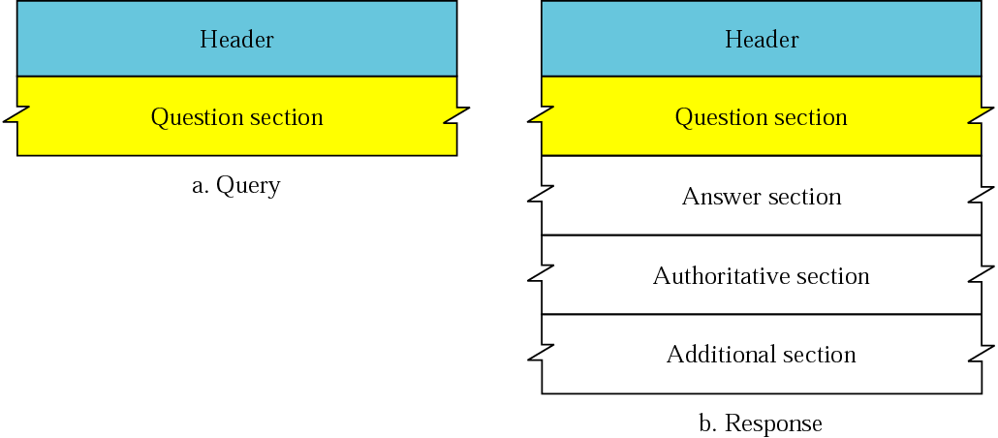
Query and response messages

Slide 54
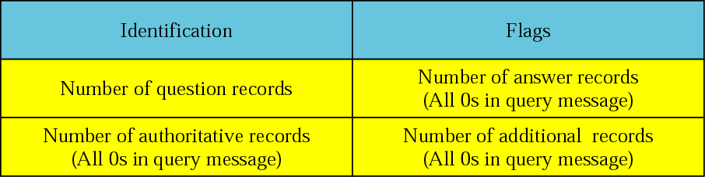
Header format

Slide 55
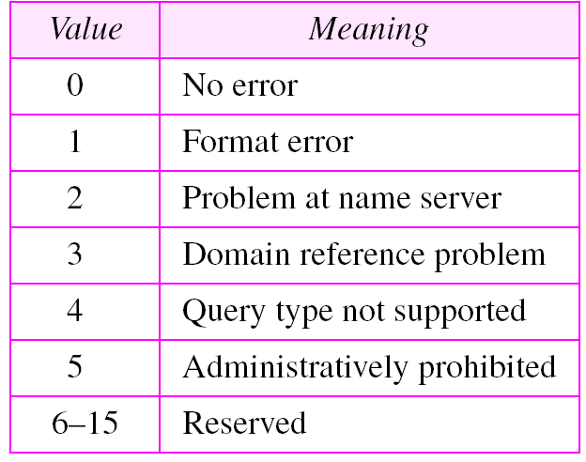
Flag fields
Values of rCode

Slide 56
Types of records
Two types of records are used in DNS
The question records are used in the question section of the query and response messages
The resource records are used in the answer, authoritative, and additional information sections of the response message

Slide 57
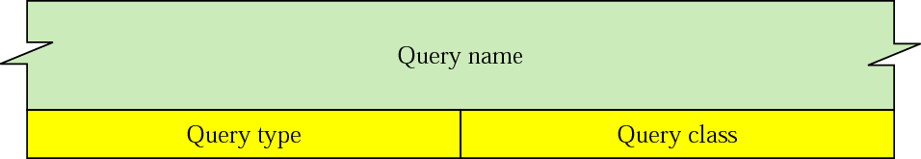
Question record format

Slide 58
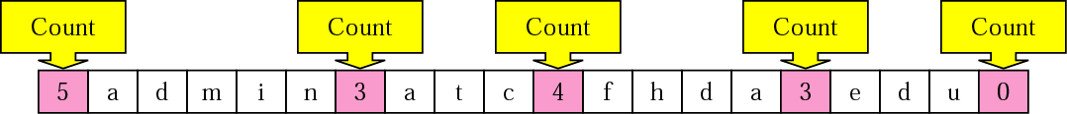
Query name format

Slide 59
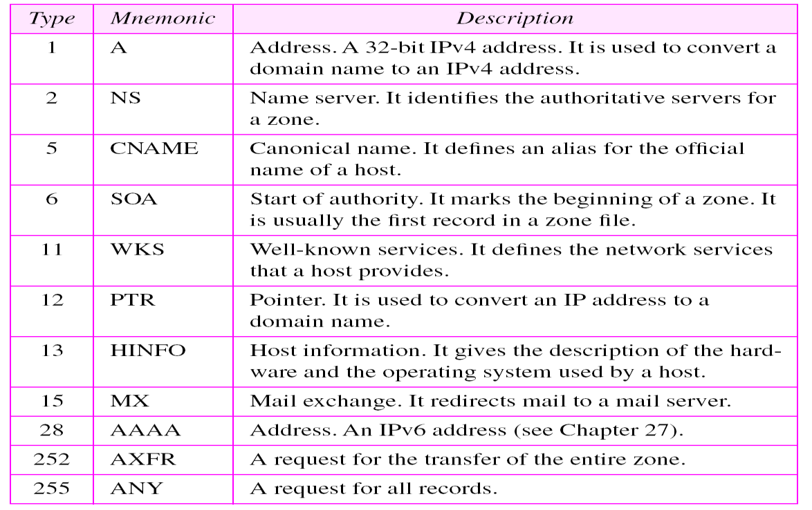
Types

Slide 60
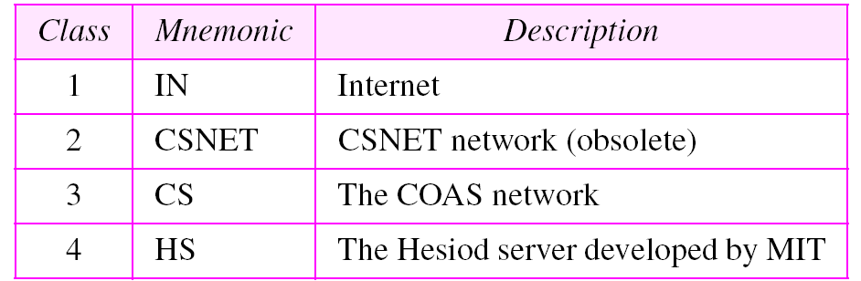
Classes

Slide 61
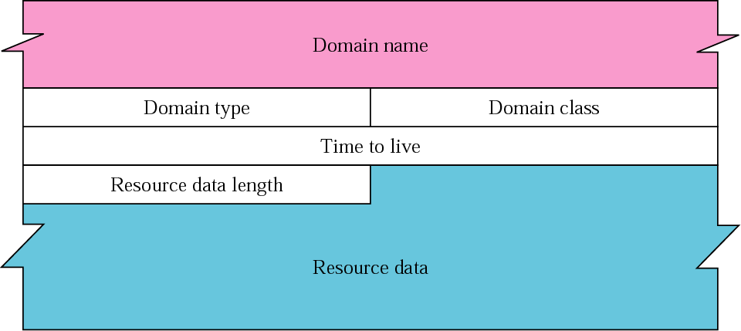
Resource record format

Slide 62
Compression
DNS Name Compression is a technique used in the Domain Name System (DNS) to reduce the size of DNS messages, especially when domain names are repeated. It helps keep DNS responses within the 512-byte limit (for UDP messages).
DNS requires that a domain name be replaced by an offset pointer if it is repeated
DNS defines a 2-byte offset pointer that points to a previous occurrence of the domain name or part of it

Slide 63
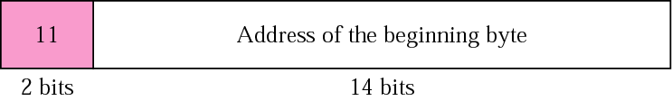
Format of an offset pointer
An offset pointer in a DNS message is a 16-bit value (2 bytes) that indicates a position earlier in the message where a domain name is already written. This allows the DNS message to avoid repeating the same domain name multiple times.
First two bits (11): These are always set to 1 1 (binary) to indicate this is a pointer, not a label.
Remaining 14 bits: Represent the offset (in bytes) from the start of the DNS message to the location of the domain name.

Slide 64
DDNS
The Dynamic Domain Name System (DDNS) updates the DNS master file dynamically

Slide 65
Encapsulation
DNS uses UDP as the transport protocol when the size of the response message is less than 512 bytes
If the size of the response message is more than 512 bytes, a TCP connection is used
DNS can use the services of UDP or TCP using the well-known port 53

Slide 66
DHCP (Dynamic Host Configuration Protocol)
DHCP is a network protocol used to automatically assign IP addresses and other network configuration parameters to devices (clients) on a network, allowing them to communicate efficiently.
DHCP Process (DORA)
D – Discover
O – Offer
R – Request
A – Acknowledge

Slide 67
DHCP Client-Server Architecture
Client: Device (e.g., laptop, phone) needing an IP address
Server: Assigns and manages IP configurations
Relay Agent: Forwards DHCP messages between clients and servers across subnets

Slide 68
Example Scenario
A laptop joins a Wi-Fi network:
Sends DHCPDISCOVER
Router replies with DHCPOFFER
Laptop sends DHCPREQUEST
Router replies with DHCPACK
Laptop gets:
IP: 192.168.1.100
Subnet: 255.255.255.0
Gateway: 192.168.1.1
DNS: 8.8.8.8

Slide 69
SMTP
SMTP is a protocol used to send emails from a client to a mail server and from one mail server to another. It operates at the Application Layer of the TCP/IP model.
Defined in RFC 5321 (updated version of RFC 821)
Works primarily over TCP port 25 (or 587 for submission, 465 for SMTP over SSL)

Slide 70
Purpose of SMTP
Sending emails from email clients (e.g., Outlook, Thunderbird) to mail servers
Transferring emails between mail servers (server-to-server communication)
SMTP is for sending only. Receiving is handled by POP3 or IMAP.

Slide 71
Architecture
Key Components:
User Agent (UA) – e.g., email client like Outlook or Thunderbird
Mail Transfer Agent (MTA) – software that sends the email (e.g., Sendmail, Postfix)
Mail Server – stores and forwards the message
To explain the architecture of email, we give few scenarios
We begin with the simplest situation and add complexity as we proceed
The fourth scenario is the most common in the exchange of email

Slide 72
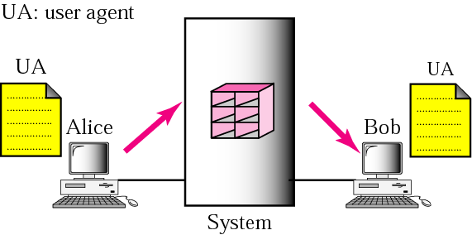
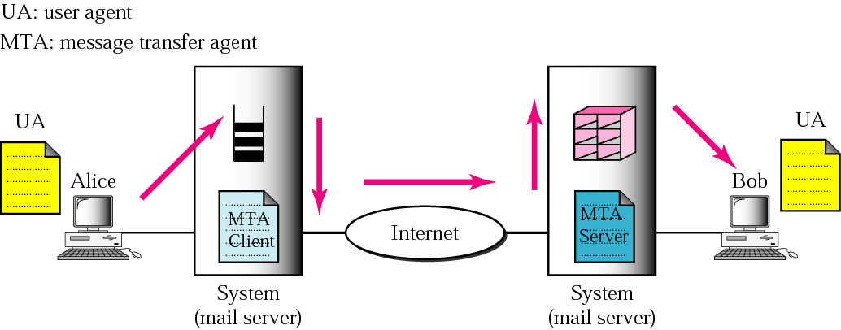
Email-Scenarios
Scenario-1
Scenario-2

Slide 73
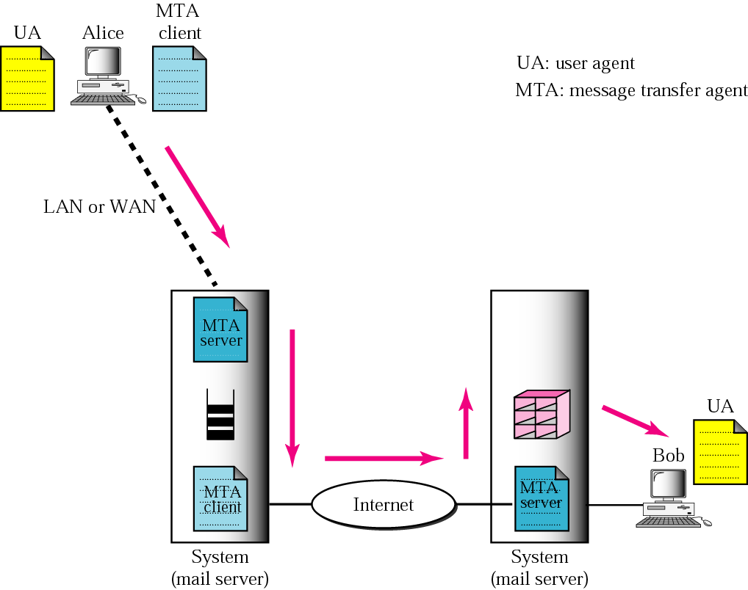
Email-Scenario
When the sender is connected to the mail server via a LAN or a WAN, we need two UAs and two pairs of MTAs (client and server)
Scenario-3

Slide 74
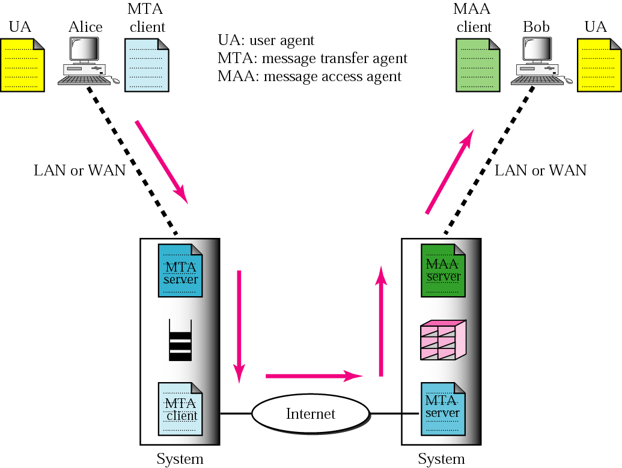
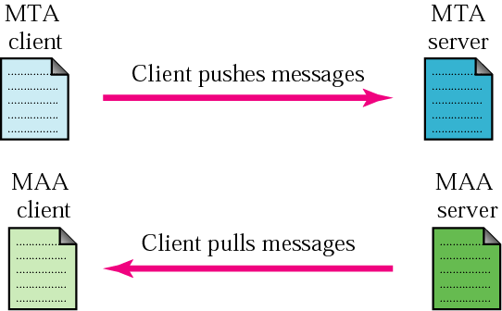
Email-Scenario
When both sender and receiver are connected to the mail server via a LAN or a WAN, we need two UAs, two pairs of MTAs (client and server), and a pair of MAAs (client and server)
This is the most common situation
Scenario-4

Slide 75

User Agent
The user agent (UA) provides service to the user to make the process of sending and receiving a message easier
Some examples of command-driven user agents are mail, pine, and elm
Some examples of GUI-based user agents are Eudora, Outlook, and Netscape

Slide 76

E-mail Format

Slide 77

Email address

Slide 78


MIME
MIME (Multipurpose Internet Mail Extensions) is an extension of the original Simple Mail Transport Protocol (SMTP) email protocol. It lets users exchange different kinds of data files, including audio, video, images and application programs, over email.

Slide 79


Data types in sub types in MIME

Slide 80

Content transfer encoding

Slide 81

What is MTA
The actual mail transfer requires message transfer agents (MTAs)
The protocol that defines the MTA client and server in the Internet is called Simple Mail Transfer Protocol (SMTP)

Slide 82

Commands and responses

Slide 83

Command

Slide 84


Response

Slide 85
Message Access Agent: POP and IMAP
The third stage of mail delivery uses a message access agent; the client must pull messages from the server
Currently two message access protocols are available
Post Office Protocol, version 3 (POP3)
Internet Mail Access Protocol, version 4

Slide 86

POP & IMAP

Slide 87

POP3

Slide 88
SMTP vs POP3 vs IMAP
Feature | SMTP | POP3 | IMAP
Purpose | Sending email | Receiving email | Receiving & syncing
Port | 25, 587, 465 | 110 (995 for SSL) | 143 (993 for SSL)
Stores mail on | Server to Server | Downloads to client | Keeps on server
Sync across devices | No | No | Yes

Slide 89
FAQ
Name the protocol used to download emails from the mail server to the client.
→ POP3 (Post Office Protocol version 3) or IMAP (Internet Message Access Protocol)
What command in SMTP is used to specify the sender’s email address?
→ MAIL FROM:
Write one key difference between POP3 and IMAP.
→ POP3 downloads and usually deletes emails from the server, while IMAP keeps emails on the server and syncs across multiple devices.
Which protocol supports offline email access but deletes emails from the server by default?
→ POP3
What is the purpose of the ‘DATA’ command in SMTP?
→ It indicates the start of the email message body (including subject, text, and attachments) and ends with a period (.) on a line by itself.

Slide 90
SSL/TLS
Secure Sockets Layer and Transport Layer Security

Slide 91
What is SSL/TLS?
SSL/TLS uses certificates to establish an encrypted link between a server and a client. This allows sensitive information like credit card details to be transmitted securely over the internet.
The certificate contains a public key that authenticates the website’s identity and allows for encrypted data transfer through asymmetric, or public-key cryptography. The matching private key is kept secret on the server.

Slide 92
How Does SSL/TLS Work?
SSL/TLS certificates authenticate identities and enable encrypted connections through the SSL/TLS handshake:
The client requests access to a protected resource such as a login page.
The server responds by sending its SSL certificate, including the public key.
The client verifies that the certificate is valid and trusted. This ensures the server is authentic.
The client generates a symmetric session key and encrypts it with the server’s public key. This securely transmits the session key to the server.
The server decrypts the session key with its private key.
Both parties use the symmetric session key to encrypt and decrypt all transmitted data.
This handshake allows the two parties to negotiate an encrypted channel without sharing sensitive information over insecure channels. The encrypted session protects data in transit between the client and server.

Slide 93

Secure Socket Layer Protocols
SSL Record Protocol
Handshake Protocol
Change-Cipher Spec Protocol
Alert Protocol

Slide 94
SSL/TLS Encryption and Keys
There are two types of encryption keys used in SSL/TLS:
Asymmetric keys – The public and private key pair are used to identify the server and initiate the encrypted session. The private key is known only to the server, while the public key is shared via a certificate.
Symmetric session keys – Disposable keys are generated for each connection and used to encrypt/decrypt transmitted data. The symmetric keys are securely exchanged using asymmetric encryption.
SSL/TLS supports multiple symmetric ciphers and asymmetric public key algorithms. For example, AES with 128-bit keys is a common symmetric cipher, while RSA and ECC commonly use asymmetric algorithms.

Slide 95
Types of SSL Certificates
There are different types of SSL certificates, each suited for different needs:
Single-Domain SSL Certificate: This type covers only one specific domain. A domain is the name of a website, like www.geeksforgeeks.org. For instance, if you have a single-domain SSL certificate for www.geeksforgeeks.org, it won't cover any other domains or subdomains.
Wildcard SSL Certificate: Similar to a single-domain certificate, but it also covers all subdomains of a single domain. For example, if you have a wildcard certificate for *.geeksforgeeks.org, it would cover www.geeksforgeeks.org, blog.www.geeksforgeeks.org, and any other subdomain under example.com.
Multi-Domain SSL Certificate: This type can secure multiple unrelated domains within a single certificate.

Slide 96
Transport Layer Security (TLS)
Transport Layer Securities (TLS) are designed to provide security at the transport layer. TLS was derived from a security protocol called Secure Socket Layer (SSL). TLS ensures that no third party may eavesdrop or tampers with any message.

Slide 97
benefits of TLS:
Encryption:
TLS/SSL can help to secure transmitted data using encryption.
Interoperability:
TLS/SSL works with most web browsers, including Microsoft Internet Explorer and on most operating systems and web servers.
Algorithm flexibility:
TLS/SSL provides operations for authentication mechanism, encryption algorithms and hashing algorithm that are used during the secure session.
Ease of Deployment:
Many applications TLS/SSL temporarily on a windows server 2003 operating systems.
Ease of Use:
Because we implement TLS/SSL beneath the application layer, most of its operations are completely invisible to client.

Slide 98
FAQ
What is the primary purpose of SSL/TLS protocols
Provide secure communication over the internet
Which port is commonly used by HTTPS (HTTP over SSL/TLS)?
443
What cryptographic techniques are used in SSL/TLS?
symmetric and asymmetric encryption
What does an SSL/TLS certificate primarily contain?
Server’s public key and identity information
Which layer of the OSI model does SSL/TLS operate at?
Session Layer (Note: It sits between Transport and Application layers, often considered as part of Session layer logic.)
In SSL/TLS, what is the purpose of the handshake protocol?
To establish authentication and encryption parameters

Slide 99

Firewalls
A firewall is a network security device or software that monitors and controls incoming and outgoing network traffic based on predetermined security rules. It acts as a barrier between trusted and untrusted networks (e.g., between a corporate LAN and the Internet).

Slide 100
Types of Firewalls
Based on Deployment
Hardware Firewall
Software Firewall
Cloud Firewall (Firewall-as-a-Service - FWaaS)
Physical device (e.g., Cisco ASA, FortiGate, Palo Alto).
Protects entire networks at the perimeter.
High performance, used in enterprises.
Installed on individual devices (e.g., Windows Defender Firewall, iptables on Linux).
Provides granular control per host.
Hosted in the cloud (e.g., AWS Security Groups, Cloudflare).
Protects cloud-based infrastructure.

Slide 101
Types of Firewalls
Based on Operation
Packet-Filtering Firewall
Examines IP headers (source/destination IP, port, protocol).
Fast but lacks deep inspection.
Operates at Layer 3 (Network) & Layer 4 (Transport).
Stateful Inspection Firewall
Tracks active connections (remembers state of sessions).
More secure than packet filtering.
Example: Cisco PIX, Netfilter (Linux).
Proxy Firewall (Application-Level Gateway)
Acts as an intermediary between users and the internet.
Inspects Layer 7 (Application Layer) traffic (e.g., HTTP, FTP).
Next-Generation Firewall (NGFW)
Combines traditional firewall + IPS/IDS, DPI, VPN, malware detection.
Uses AI/ML for threat detection.
Example: Palo Alto, Fortinet.

Slide 102
How Firewalls Work
Default Policies:
Allow by default (Permissive) – Blocks only explicitly denied traffic.
Deny by default (Restrictive) – Allows only explicitly permitted traffic (recommended).
Rule-Based Filtering:
Rules define what traffic is allowed/blocked (e.g., "Allow HTTP from 192.168.1.0/24").
Network Address Translation (NAT):
Masks internal IPs behind a single public IP.
VPN Support:
Some firewalls include VPN for secure remote access.

Slide 103
Firewall Best Practices
Use a multi-layered approach (e.g., perimeter firewall + host-based firewall).
Regularly update firewall rules (remove unused rules to minimize attack surface).
Enable logging & monitoring (detect intrusion attempts).
Segment networks (use internal firewalls for VLANs/departments).
Disable unnecessary services (e.g., Telnet, FTP if not used).
Use Intrusion Prevention Systems (IPS) alongside firewalls.

Slide 104
Limitations of Firewalls
Cannot prevent internal threats (e.g., malicious insider).
Limited against zero-day exploits (unless using AI/ML-based NGFW).
Encrypted traffic (SSL/TLS) can bypass inspection unless decrypted.

Slide 105
What is Cryptography?
Cryptography is the study of techniques for preventing access to sensitive data by parties who are not authorized to access the data.
Cryptanalysis is the study of techniques for breaking cryptographic systems.
Cryptology = Cryptography + Cryptanalysis
Cryptanalysis is useful for strengthening cryptographic primitives.
Maintaining security and privacy is an ancient and primitive need.
Particularly relevant for military and diplomatic applications.
Wide deployment of the Internet makes everybody a user of cryptographic tools.

Slide 106
Cryptography is Everywhere
Secure communication:
web traffic: HTTPS
wireless traffic: 802.11i WPA2 (and WEP), GSM, Bluetooth
Encrypting files on disk: EFS, TrueCrypt
Content protection:
CSS (DVD), AACS (Blue-Ray)
User authentication
Kerberos, HTTP Digest
… and much much more

Slide 107
Goal: Protect Alice’s Communications with Bob
Alice
E
c
Public Channel
c
D
Bob
message m = “I {Like,Hate} you”
Eve
Eve is a very powerful, smart person (say any polynomial time alg)

Slide 108

History of Cryptography
David Kahn, “The code breakers” (1996)

Slide 109

Caesar Cipher: c = m + 3
A B C D E F G H I J K L M N O P Q R
S T U V W X Y Z
Julius Caesar
100 BC- 44 BC

Slide 110
Information needs to be secured
To be secured, information needs to be hidden from
unauthorized access (confidentiality)
protected from unauthorized change (integrity)
available to an authorized entity when it is needed (availability)

Slide 111

Security Threats

Slide 112
Traditional Ciphers
We now look at the first goal of security, confidentiality
Confidentiality can be achieved using ciphers
Traditional ciphers are called symmetric-key ciphers (or secret-key ciphers) because the same key is used for encryption and decryption and the key can be used for bidirectional communication

Slide 113

General idea of traditional cipher
A substitution cipher replaces one symbol with another

Slide 114

Representation of characters in modulo 26
In additive cipher, the plaintext, ciphertext, and key are integers in modulo 26

Slide 115

Example
Use the additive cipher with key = 15 to encrypt the message “hello”
Solution
The cipher is mono-alphabetic because two instances of the same plaintext
character (ls) are encrypted as the same character (A). The result is “WTAAD”

Slide 116
Example
Use the additive cipher with key = 15 to decrypt the message “WTAAD”.
Solution
We apply the decryption algorithm to the plaintext character by character. The result is “hello”. Note that the operation is in modulo 26, which means that we need to add 26 to a negative result (for example -15 becomes 11).

Slide 117


Transposition cipher
A transposition cipher reorders symbols
Plaintext
Plaintext
e n e m y a t t a c k s t o n i g h t z
e n e m y a t t a c k s t o n i g h t z
Write row by row
Read row by row
e a k i
n t s g
e t t h
m a
e a k i
n t s g
e t t h
m a
y c
o n
z
y c
o n
z
t
t
E T T H
E A K I
M Y
A C
O N
T Z
N T S G
E T T H
E A K I
M Y
A C
O N
T Z
N T S G
Read column by column
Write column by column
E T T H E A K I MA O T Y C N Z N T S G
E T T H E A K I MA O T Y C N Z N T S G
Ciphertext
Ciphertext

Slide 118
Modern ciphers
The traditional symmetric-key ciphers that we have studied so far are character- oriented ciphers
With the advent of the computer, we need bit-oriented ciphers
This is because the information to be encrypted is not just text; it can also consist of numbers, graphics, audio, and video data
It is convenient to convert these types of data into a stream of bits, to encrypt the stream, and then to send the encrypted stream
A modern block cipher can be either a block cipher or a stream cipher

Slide 119

Modern ciphers

Slide 120

Components of Modern ciphers

Slide 121


General structure of DES

Slide 122

DES function

Slide 123

DES key generation

Slide 124
Example
We choose a random plaintext block, a random key, and a computer program to determine what the ciphertext block would be (all in hexadecimal):

Slide 125

Example
To check the effectiveness of DES, when a single bit is changed in the input, let us use two different plaintexts with only one single bit difference. The two ciphertexts are completely different without even changing the key:
Although the two plaintext blocks differ only in the rightmost bit, the ciphertext blocks differ in 29 bits

Slide 126

One time pad

Slide 127
Asymmetric key ciphers
Symmetric-key and asymmetric-key ciphers will exist in parallel and continue to serve the community
We actually believe that they are complements of each other
The advantages of one can compensate for the disadvantages of the other
Symmetric-key cryptography is based on sharing secrecy
Asymmetric-key cryptography is based on personal secrecy
In symmetric-key cryptography, symbols are permuted or substituted
in asymmetric-key cryptography, numbers are manipulated

Slide 128

Asymmetric key ciphers
Asymmetric-key ciphers are sometimes called public-key ciphers

Slide 129



General idea of asymmetric key ciphers

Slide 130


Encryption, decryption and key in RSA

Slide 131

Example
For the sake of demonstration, let Bob choose 7 and 11 as p and q and calculate n = 7 × 11 = 77
The value of φ(n) = (7 − 1)(11 − 1), or 60. If he chooses e to be 13, then d is 37.
Note that e × d mod 60 = 1
Now imagine that Alice wants to send the plaintext 5 to Bob. She uses the public exponent 13 to encrypt 5. This system is not safe because p and q are small

Slide 132

Digital signature
A digital signature is a mathematical scheme for verifying the authenticity of digital messages or documents. A valid digital signature on a message gives a recipient confidence that the message came from a sender known to the recipient

Slide 133
Assurances About Digital Signatures
Authenticity: The identity of the signer is verified.
Integration: Since the content was digitally signed, it hasn't been altered or interfered with.
Non-repudiation: demonstrates the source of the signed content to all parties. The act of a signer denying any affiliation with the signed material is known as repudiation.
Notarization: Under some conditions, a signature in a Microsoft Word, Microsoft Excel, or Microsoft PowerPoint document that has been time-stamped by a secure time-stamp server is equivalent to a notarization.

Slide 134
Benefits of Digital Signatures
Legal documents and contracts: Digital signatures are legally binding. This makes them ideal for any legal document that requires a signature authenticated by one or more parties and guarantees that the record has not been altered.
Sales contracts: Digital signing of contracts and sales contracts authenticates the identity of the seller and the buyer, and both parties can be sure that the signatures are legally binding and that the terms of the agreement have not been changed.
Financial Documents: Finance departments digitally sign invoices so customers can trust that the payment request is from the right seller, not from a attacker trying to trick the buyer into sending payments to a fraudulent account.
Health Data: In the healthcare industry, privacy is paramount for both patient records and research data. Digital signatures ensure that this confidential information was not modified when it was transmitted between the consenting parties.

Slide 135
Drawbacks of Digital Signature
Dependency on technology: Because digital signatures rely on technology, they are susceptible to crimes, including hacking. As a result, businesses that use digital signatures must make sure their systems are safe and have the most recent security patches and upgrades installed.
Complexity: Setting up and using digital signatures can be challenging, especially for those who are unfamiliar with the technology. This may result in blunders and errors that reduce the system's efficacy. The process of issuing digital signatures to senior citizens can occasionally be challenging.
Limited acceptance: Digital signatures take time to replace manual ones since technology is not widely available in India, a developing nation.

Slide 136
THANK YOU

